Slide 1

DEPARTMENT OF COMPUTER SCIENCE AND ENGINEERING
Professional Training I
Donation and Campaign Tracker
Q-FundTrack: Cloud-Based Donation and Campaign Management System
PROJECT STUDENT GUIDE
Pranab kr. Santra, reg # 44111130 Ms. Kalaivani A, M.E Associate Professor, CSE

Slide 2
AGENDA
Certificate
Abstract
Introduction
Objective
System Architecture / Ideation Map
Module Implementation
Results and Discussions
Conclusion
References

Slide 3
ABSTRACT
The Donation & Campaign Tracker is a cloud-based web application designed to help non-profit organizations manage fundraising campaigns, donor information, and donation records efficiently. The system enables administrators to create campaigns, record contributions, monitor fundraising progress, and maintain donor records through a centralized platform.
The application uses Django and Python for the backend, Amazon RDS for database management, Amazon S3 for document storage, and Amazon SNS for notifications. The application is deployed using Amazon EC2. A dashboard provides campaign-wise progress and donation statistics, helping organizations monitor their fundraising activities effectively.

Slide 4
INTRODUCTION
NGOs and organizations often manage donations using spreadsheets or manual records.
Managing multiple campaigns and donors can become difficult.
Tracking campaign targets and actual contributions requires centralized data.
The proposed system provides a single platform for managing campaigns and donations.
AWS cloud services provide storage, database management, deployment, and notifications.

Slide 5
OBJECTIVES
To develop a centralized donation and campaign management system.
To maintain donor and donation records efficiently.
To create and monitor fundraising campaigns.
To track campaign targets and achieved amounts.
To securely store campaign-related documents.
To provide automated notifications and summaries.
To deploy the application using AWS cloud services.

Slide 6
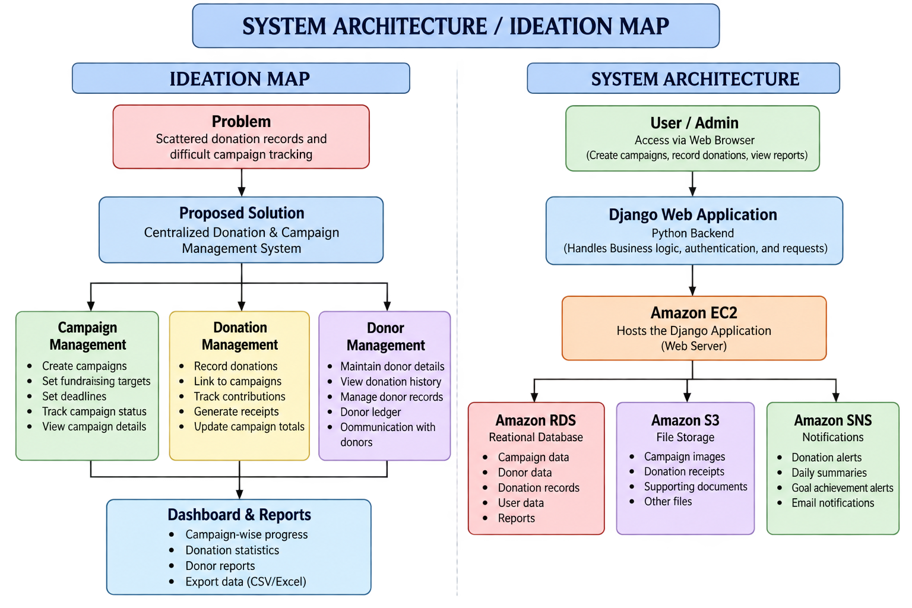
System Architecture / Ideation Map

Slide 7
Module Implementation
Module 1: User & Admin Management
Module 2: Campaign Management
Module 3: Donation Management
Module 4: Dashboard & Reports
Module 5: AWS Integration
  EC2 Deployment
  RDS DB
  S3 Storage
  SNS Notification

Slide 8
RESULTS and DISCUSSION

Slide 9
CONCLUSION
The Donation & Campaign Tracker can provide a centralized and efficient platform for managing fundraising campaigns, donor information, and donation records. The integration of AWS services such as EC2, RDS, S3, and SNS demonstrates the practical application of cloud computing in non-profit management. The system improves data organization, campaign monitoring, and communication while providing a foundation for future enhancements such as online payment integration and advanced analytics.

Slide 10
REFERENCES
[1]. AWS documentation
[2]. Django documentation
[3]. Python documentation
[4]. MySQL/PostgreSQL documentation

Slide 11
THANK YOU
I thank God, Our Department, Guide, Panel Members, Supportive Professors and her who helped me supporting in my Project.

